Slide 1



Analyzing Promotion Effectiveness at AtliQ Mart
ATLIQ
Insights from Diwali 2023 and Sankranti 2024 Promotions

Slide 2







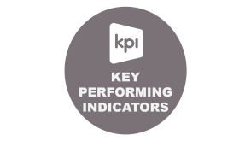

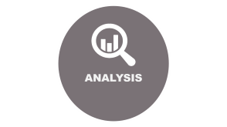
CONTENTS

Slide 3

INTRODUCTION

Slide 4
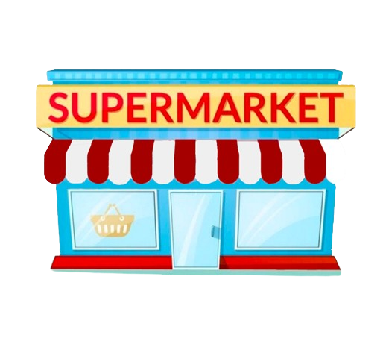

ATLIQ MART
One of the Southern India’s Retail Giant
INTRODUCTION
50 stores across India
Seamless Shopping Experience
Diverse Product Range

Slide 5
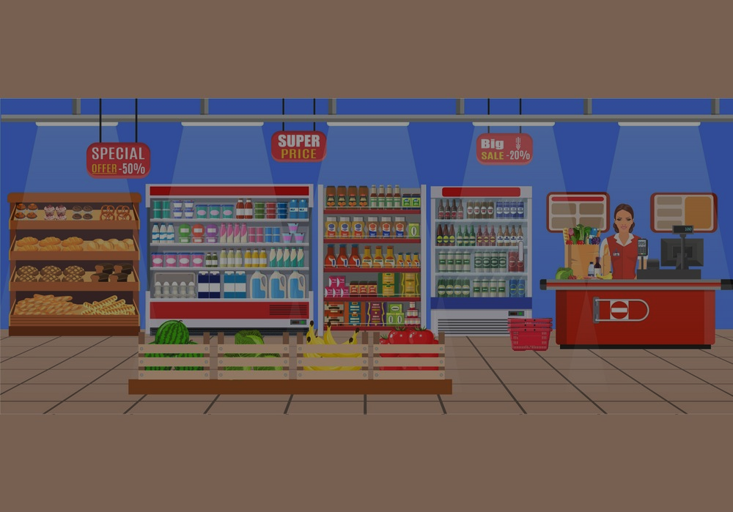
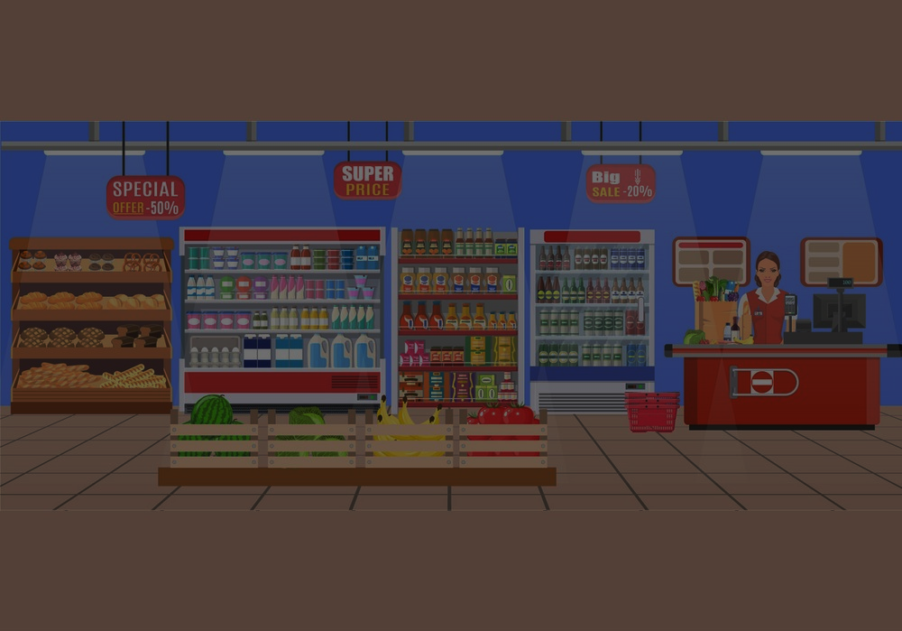
INTRODUCTION
Overview :
, a prominent retail giant, operates over 50 supermarkets in southern India. Renowned for its diverse product range and customer-centric approach, it provides a seamless shopping experience.
All their 50 stores ran a massive promotion during the Diwali 2023 and Sankranti 2024 (festive time in India) on their AtliQ branded products. Now the sales director wants to understand which promotions did well and which did not so that they can make informed decisions for their next promotional period.
ATLIQ MART

Slide 6

BACKGROUND INFO

Slide 7

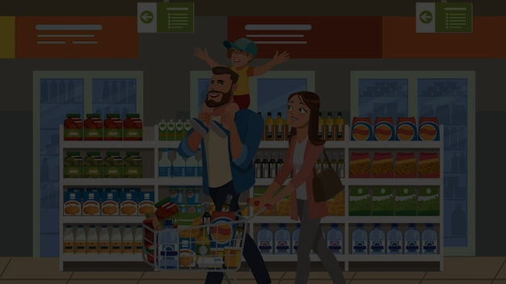
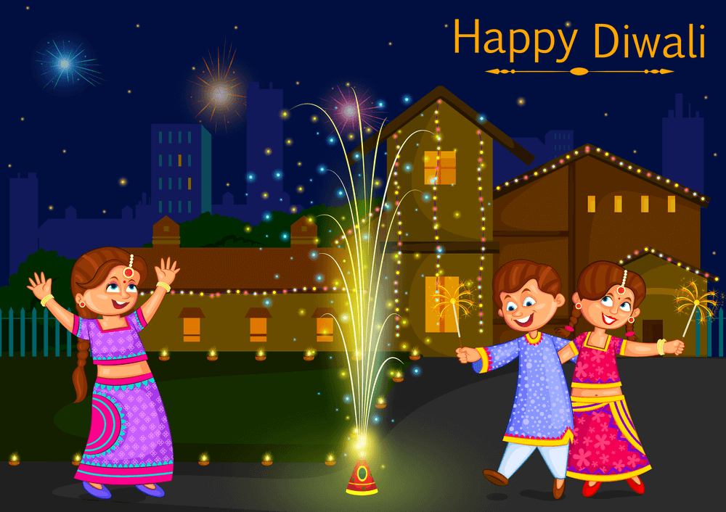

PROMOTIONAL CAMPAIGNS IN FESTIVALS
BACKGROUND INFO
DIWALI
SANKRANTI
Impact of festive seasons on consumer behavior:
Festive seasons witness increased spending on gifts, clothing, and household items as people prepare for celebrations.
Cultural significance of Diwali and Sankranti in India:
Diwali is the festival of lights celebrated by Hindus, symbolizing the victory of light over darkness and good over evil.
Sankranti marks the harvest festival in India, celebrated with various regional customs and traditions.
Impact of festive seasons on consumer behavior:
Festive seasons witness increased spending on gifts, clothing, and household items as people prepare for celebrations.
Role of promotions in driving sales during festivals:
Promotions attract customers with special discounts and offers, stimulating purchase decisions and boosting sales volume.

Slide 8
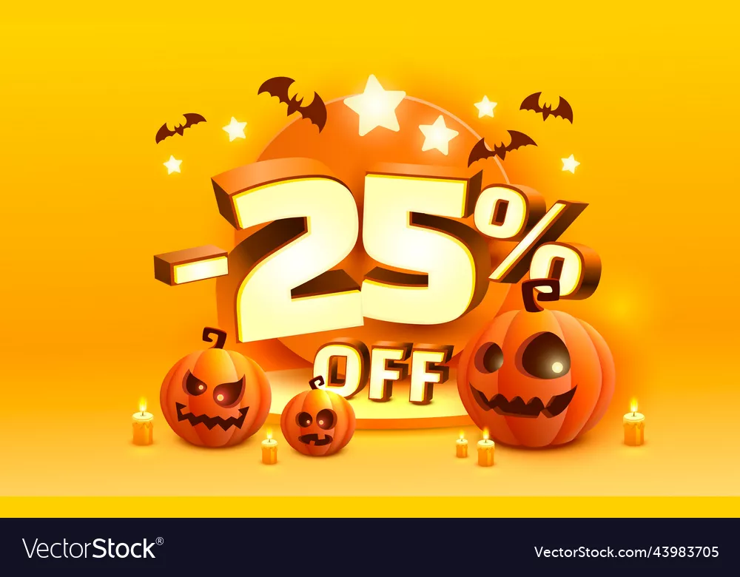
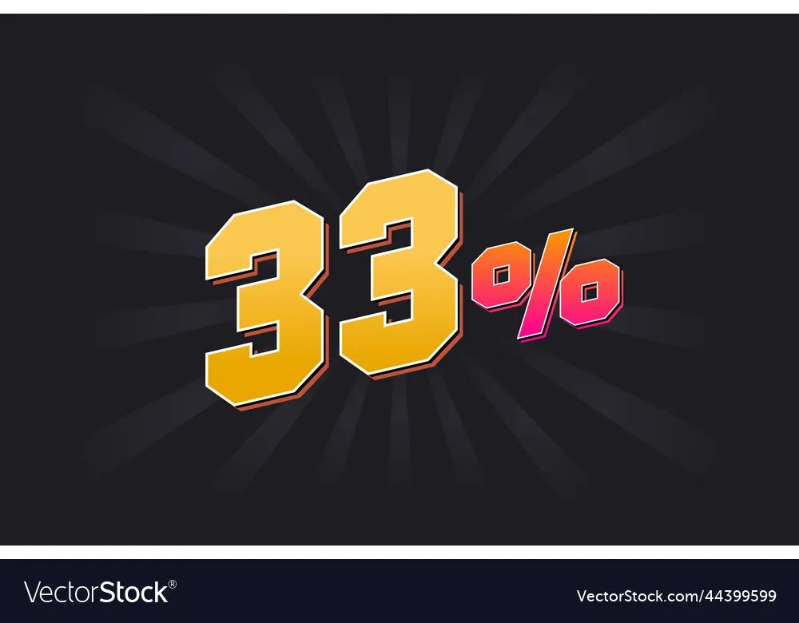


PROMOTIONAL CAMPAIGNS IN FESTIVALS
ATLIQ MART runs an a massive promotion during the Diwali 2023 and Sankranti 2024 (festive time in India) on their AtliQ branded products by the means of various promotional offers.

Slide 9

PROBLEM AND OBJECTIVES

Slide 10

PROBLEM AND OBJECTIVES

Slide 11
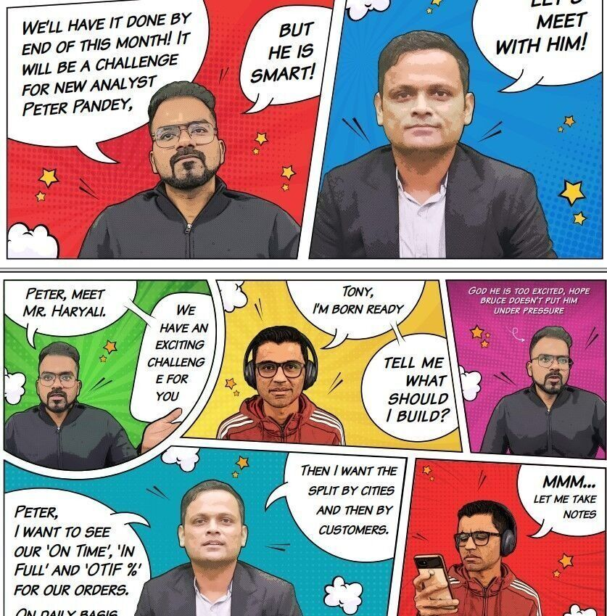
PROBLEM
Problem Statement:
The sales director Bruce Haryali wants to understand which promotions did well and which did not during Diwali 2023 and Sankranti 2024. So that they can make informed decisions for their next promotional period. during Diwali 2023 and Sankranti 2024.
Bruce Haryali
Sales Director
AtliQ Mart

Slide 12
OBJECTIVES AND GOAL
Objectives :
The company wants to do certain Analysis :
Answers of 5 Ad – Hoc Analysis questions in SQL
A self – explanatory Power BI Dashboard
Goals :
To evaluate the effectiveness of promotions during these festive periods.
To provide actionable insights for improving future promotional strategies.

Slide 13
WHO WILL DO THE TASK ?
Peter Pandey, who is the curious data analyst of AtliQ Mart was given the task to do the task
To do Ad-hoc SQL queries
to build an effective Power BI dashboard
to achieve the required analysis.
Peter Pandey
Data Analyst
AtliQ Mart

Slide 14

ITS TIME TO ROLEPLAY
In this project,
I’m playing the role of Peter Pandey
Peter Pandey
Data Analyst
AtliQ Mart

Slide 15

METHODOLOGY

Slide 16


METHODOLOGY
Analysis techniques used:
Statistical analysis to identify correlations.
Data visualization to present findings effectively.
Comparative analysis to assess promotion performance.

Slide 17

ANALYSIS

Slide 18






ANALYSIS
TOOLS

Slide 19

POWER BI

Slide 20


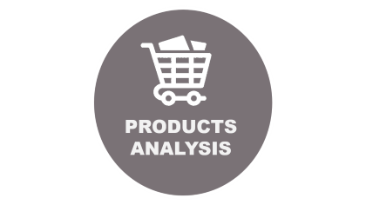
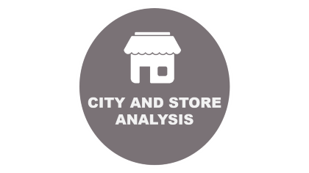
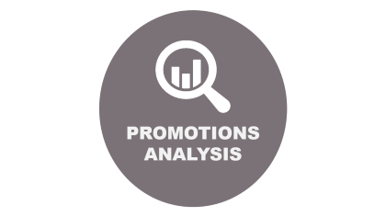

POWER BI

Slide 21

SQL

Slide 22

Ad_Hoc Insights
Promotion effectiveness Analysis

Slide 23
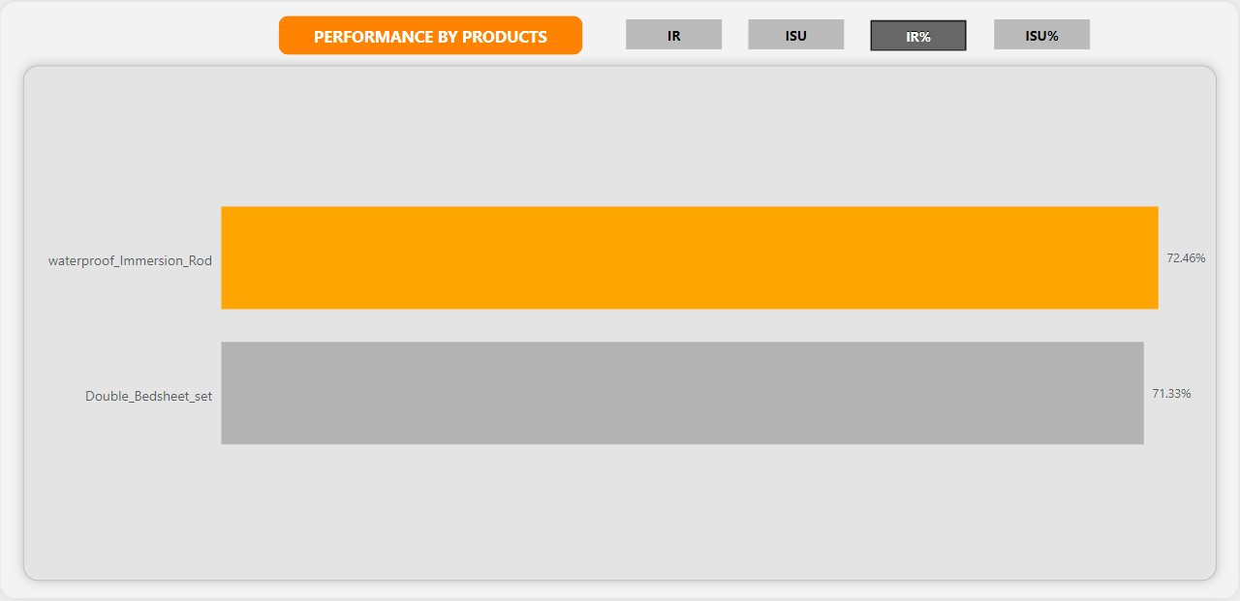
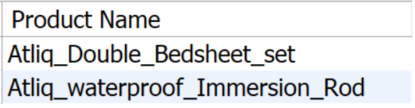
REQUEST 1
Follow : List of products with a base price greater than 500 and that are featured in promo type of 'BOGOF' (Buy One Get One Free).
This information will help us identify high-value products that are currently being heavily discounted, which can be useful for evaluating our pricing and promotion strategies.

Slide 24
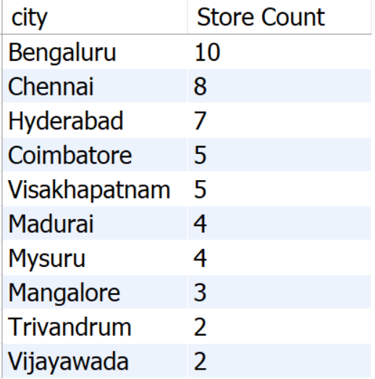
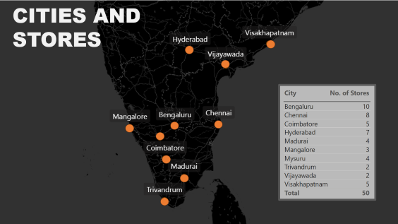
REQUEST 2
Follow : Overview of the number of stores in each city. The results will be sorted in descending order of store counts, allowing us to identify the cities with the highest store presence. The report includes two essential fields: city and store count.
Insights:
In Banglore, AtliQ Mart has highest no. of stores.
Trivendrum and Vijaywada has lowest store presence and that’s 2.

Slide 25
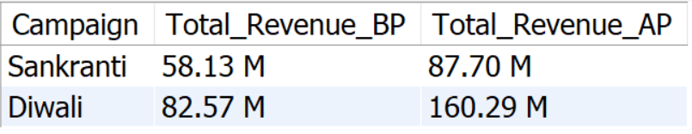
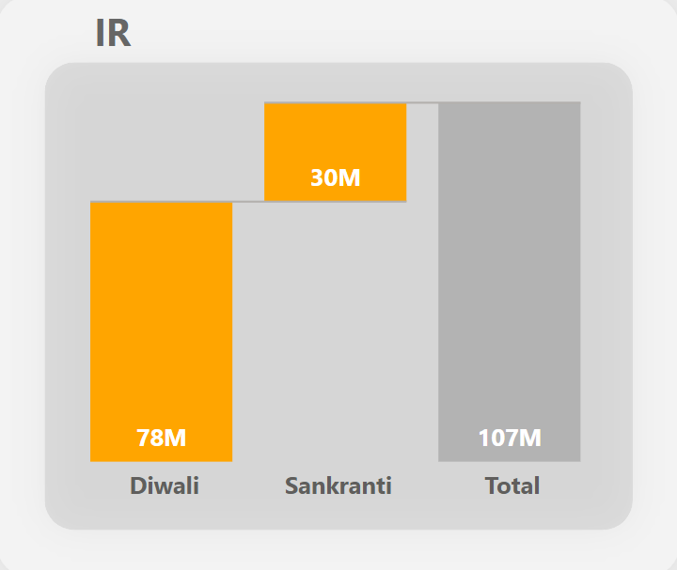
REQUEST 3
Follow : Generate a report that displays each campaign along with the total revenue generated before and after the campaign? The report includes three key fields: campaign_name, total_revenue(before_promotion), total_revenue(after_promotion).
Insights :
It suggested that Diwali Campaign receives higher increase in revenue than that of Sankranti. Increase in revenue for : -
Diwali : 77.72
Sankranti : 29.7
This report should help in evaluating the financial impact of our promotional campaigns.

Slide 26
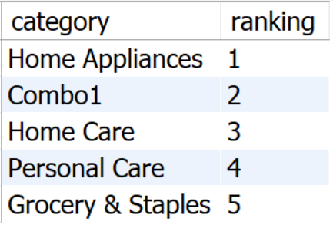
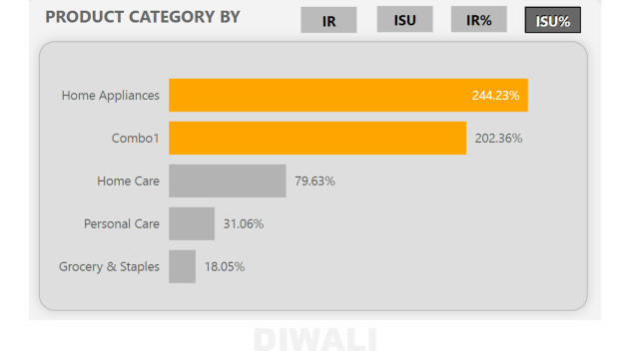
REQUEST 4
Follow : Produce a report that calculates the Incremental Sold Quantity (ISU%) for each category during the Diwali campaign. Additionally, provide rankings for the categories based on their ISU%. The report include three key fields: category, ISU%, and rank order.
Insights :
Home appliances has highest 244.23 ISU%
Groceries and staples has lowest ranking with 18.05 ISU % .
This information will assist in assessing the category-wise success and impact of the Diwali campaign on incremental sales.

Slide 27
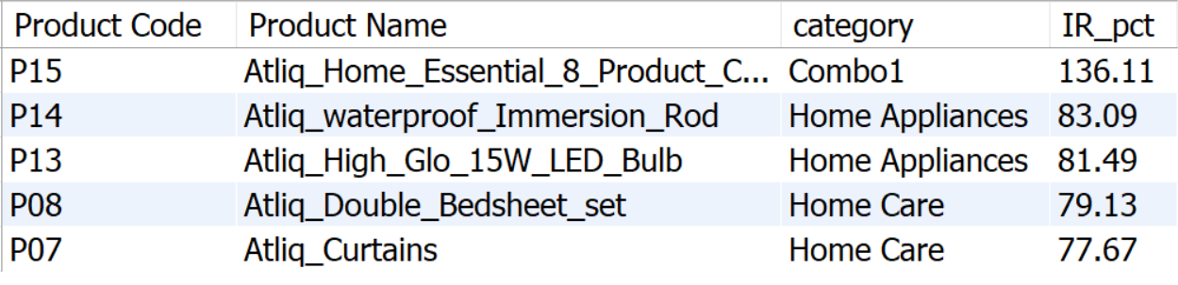
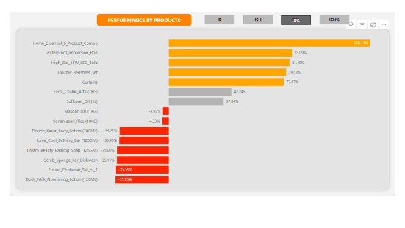
REQUEST 5
Follow : Create a report featuring the Top 5 products, ranked by Incremental Revenue Percentage (IR%), across all campaigns. The report will provide essential information including product name, category, and IR%.
This analysis helps identify the most successful products in terms of incremental revenue across our campaigns, assisting in product optimization.

Slide 28

PROMOTION TYPES

Slide 29


PROMOTION TYPES
During the festival campaigns AtliQ Mart gives promotional offers which are : -
50 % OFF
BUY 1 GET 1 FREE
33 % OFF
500 CASHBACK
25 % OFF

Slide 30

KEY PERFORMING INDICATORS

Slide 31

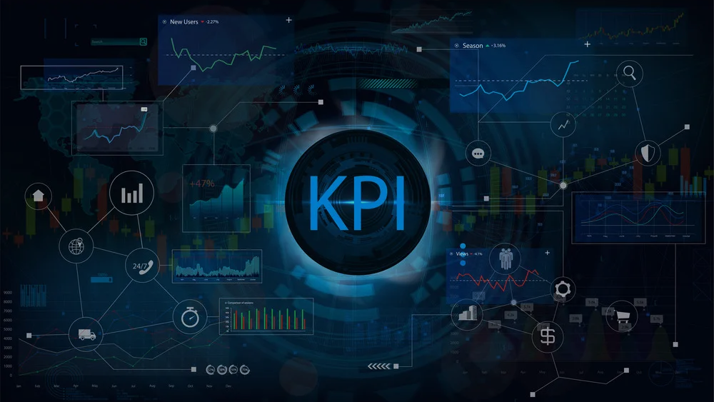
KEY PERFORMING INDICATORS
Incremental Revenue : It represents the difference between the revenue generated before and after the promotions.
Incremental Sold Unit : It represents the difference between the total unit sold before and after the promotions.
Incremental Revenue % : It represents the percentage increase in revenue after the promotions.
Incremental Sold Unit % : It represents the percentage increase in total sold unit after the promotions.
Incremental Revenue Ratio : It represents the ratio of IR to ISU.

Slide 32

DATA OVERVIEW

Slide 33



DATA OVERVIEW
The dataset for the analysis is curated by Codebasics in their Resume Challenge 9. This Dataset consists of 4 CSV files which are : -
Dim_campaigns
Dim_products
Dim_stores
Fact_events

Slide 34




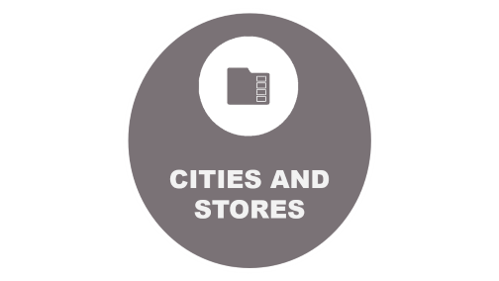
DATA OVERVIEW

Slide 35
CITIES AND STORES

Slide 36
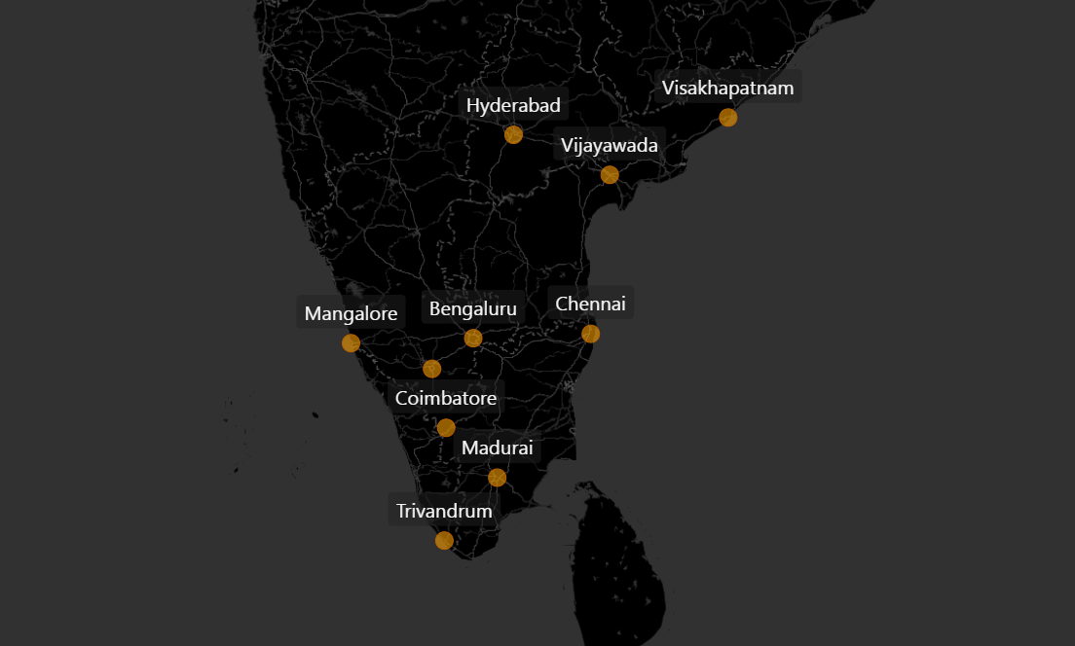
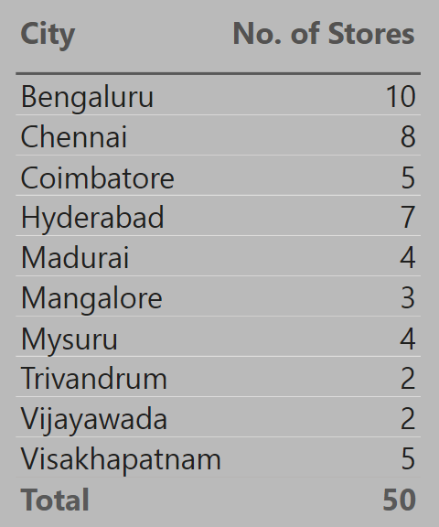
CITIES AND STORES

Slide 37
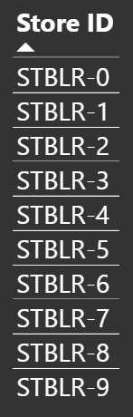
BENGALURU

Slide 38
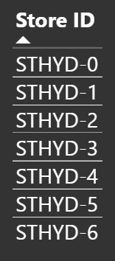
HYEDARABAD

Slide 39
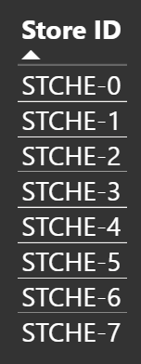
CHENNAI

Slide 40
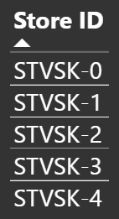
VISHAKHAPATNAM

Slide 41
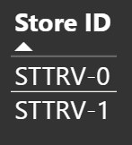
TRIVEDRUM

Slide 42
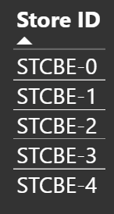
COIMBATORE

Slide 43
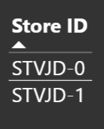
VIJAYWADA

Slide 44
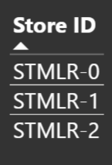
MANGLORE

Slide 45
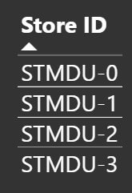
MADURAI

Slide 46
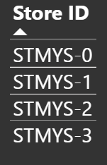
MYSORE

Slide 47

PRODUCTS

Slide 48
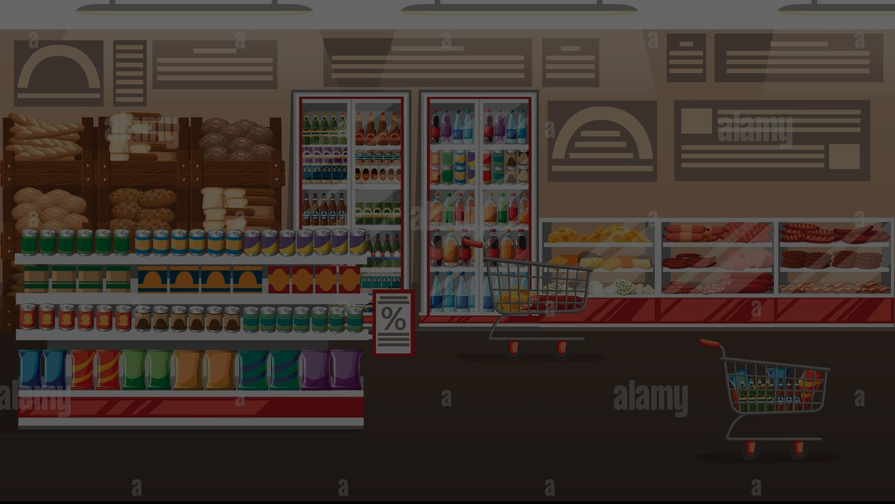
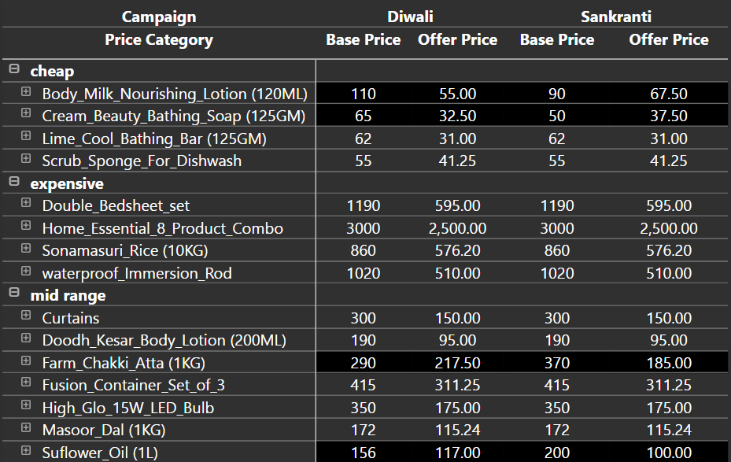

PRODUCTS
Price Category
Category | Price Range
Cheap | 0 – 100
Mid Range | 100 - 500
Expensive | 500 +

Slide 49
PROMOTIONS ANALYSIS

Slide 50


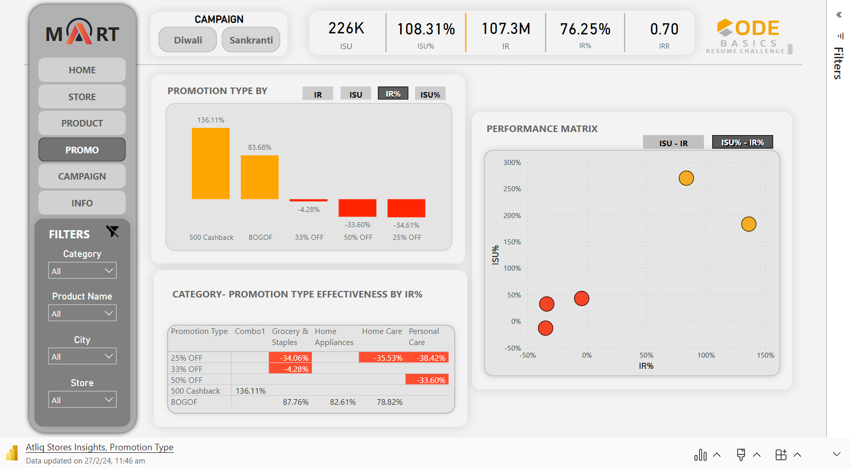
PROMOTIONS ANALYSIS

Slide 51
PROMOTIONS ANALYSIS
INSIGHTS
The "Buy One, Get One Free" (BOGOF) promotion achieved notable success in both ISU and ISU% metrics.
The "500 Cashback" promotion ranked highest in terms of IR%.
Promotions utilizing percentage discounts showed negative impacts on IR%.
Specifically, the 25% off offer emerged as the least performing promotion type.

Slide 52
PRODUCTS ANALYSIS

Slide 53


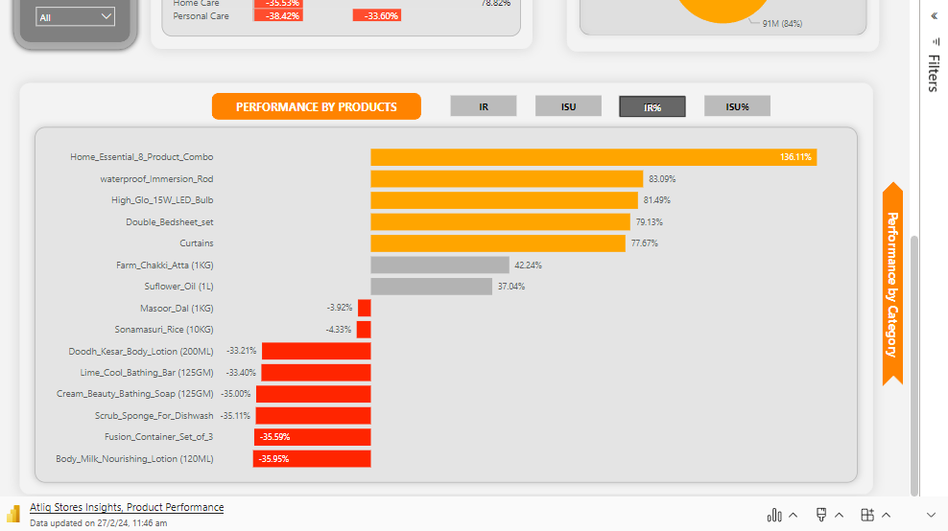
PRODUCTS ANALYSIS

Slide 54
PRODUCTS ANALYSIS
INSIGHTS
The Home Appliance category consistently outperformed others in terms of Incremental Sales Units Percentage (ISU%) across all campaigns, indicating its robust performance.
During the Diwali campaign, the Combo1 Category emerged as the leader in terms of Incremental Revenue Percentage (IR%), but during the Sankranti Campaign, it was surpassed by the Home Appliances category, showcasing dynamic shifts in performance across campaigns.
Despite experiencing a notable 25% increase in units sold (ISU%), the Personal Care category still incurred negative Incremental Revenue Percentage (IR%) overall, highlighting a disparity between sales volume and revenue generation.
Products featuring the "Buy One, Get One Free" (BOGOF) promotional type consistently emerged as top performers throughout the campaigns, indicating the effectiveness of this promotional strategy.

Slide 55
PRODUCTS ANALYSIS
INSIGHTS
The Home_Essential_8_Product_Combo demonstrated exceptional performance, leading in terms of Incremental Revenue Percentage (IR%).
Conversely, products such as the Fusion_Container_set_of_3 and Scrub_Sponge_for_Dishes exhibited both negative Incremental Revenue Percentage (IR%) and Incremental Sales Units Percentage (ISU%), marking them as the poorest performing products throughout the campaigns.
Groceries and Staples collectively accounted for over half (53%) of the Incremental Sales Units (ISU) generated throughout the overall campaign, emphasizing their significance in driving sales.
The Combo1 Category alone represented a substantial 84% of the Total Incremental Revenue (IR), underscoring its dominance in revenue generation across the campaigns.

Slide 56

CITY AND STORE ANALYSIS

Slide 57


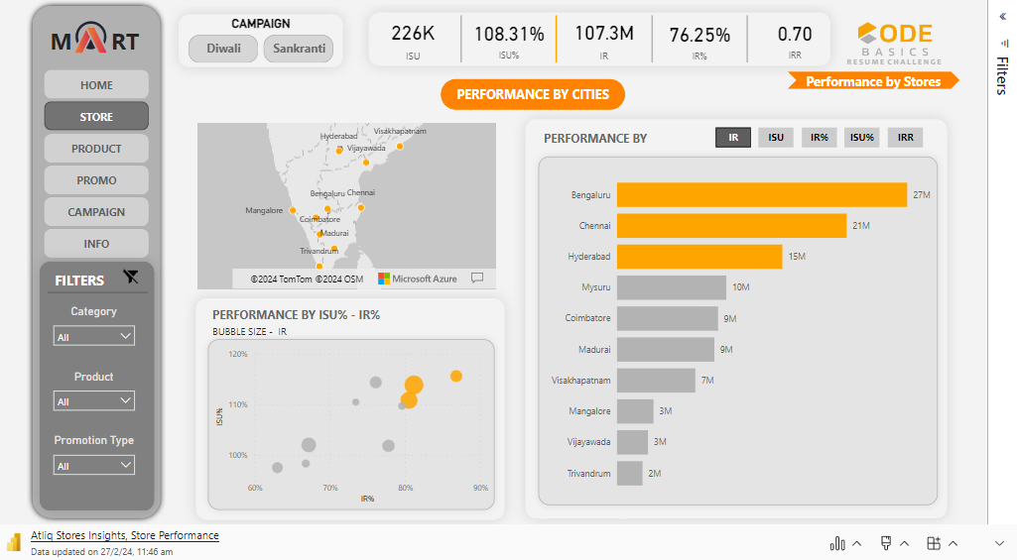
CITY AND STORE ANALYSIS

Slide 58
CITY AND STORE ANALYSIS
INSIGHTS
The top-performing cities consistently show exceptional performance metrics:
Their top three product's Incremental Revenue Percentage (IR%) averages over 90%.
Their Incremental Sales Units Percentage (ISU%) averages over 275%.
The top three best-performing cities during the campaign were Banglore, Madurai, and Chennai.
Despite having the least number of operating stores, Vijaywada exhibited exceptional performance throughout the campaigns.
Top-performing stores share a common trait:
Products with the lowest Incremental Revenue (IR), often negative, are less negative compared to those of the least performing stores.
This indicates a higher level of overall store performance, even for products with relatively lower revenue contributions.
STORE ID | CITY
STBLR-7 | BANGLORE
STCBE-2 | COIMBATORE
STMYS-1 | MYSURE
STMDU-0 | MADURAI
STCHE-7 | CHENNAI

Slide 59

CAMPAIGN COMPARISON

Slide 60
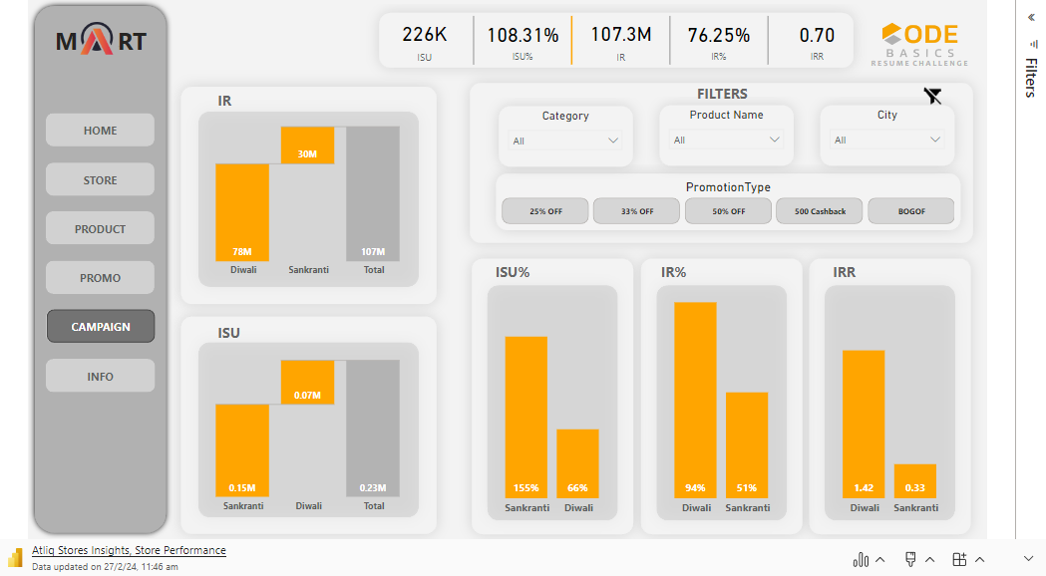
CAMPAIGN COMPARISON

Slide 61
CAMPAIGN COMPARISON
INSIGHTS
The Diwali Campaign generated a higher Incremental Revenue Percentage (IR%) compared to the Sankranti Campaign.
Conversely, the Sankranti Campaign exhibited a higher Incremental Sales Units Percentage (ISU%) compared to Diwali.
That’s because Diwali campaign witnessed massive sold out of Combo1 (Highest Offer Price) compared to that of Sankranti.

Slide 62

INSIGHTS

Slide 63

CONCLUSION

Slide 64




Slide 65



Slide 66
CATEGORY ANALYSIS

Slide 67
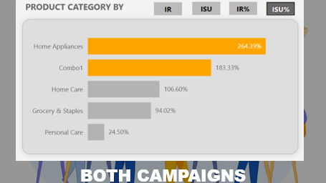
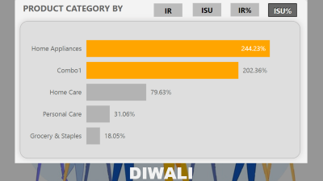
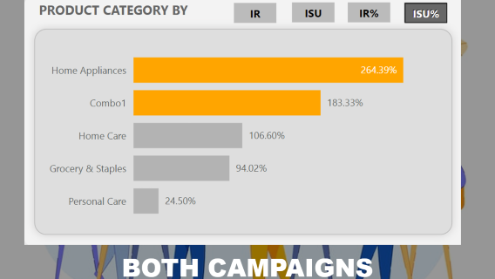
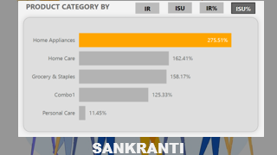


CATEGORY ANALYSIS
These Bar Graphs shows the ISU% in respect of the 5 categories of the products .
Observations from the graphs are :
The ISU% of Home Appliances is tremendous in all the campaigns.
Personal care Category have lowest ISU% in both the campaigns.
ISU% (Percentage Increase in Sold Units in following campaign compared to the week before the campaign.)

Slide 68
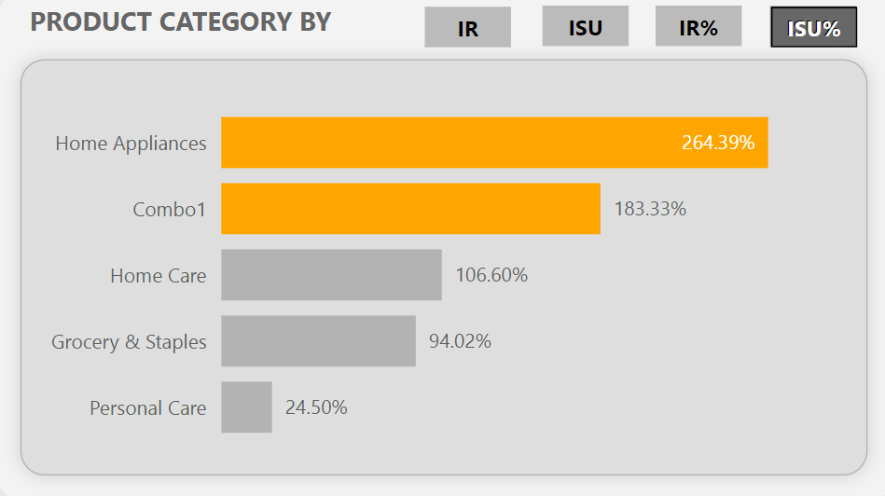
BOTH CAMPAIGNS

Slide 69
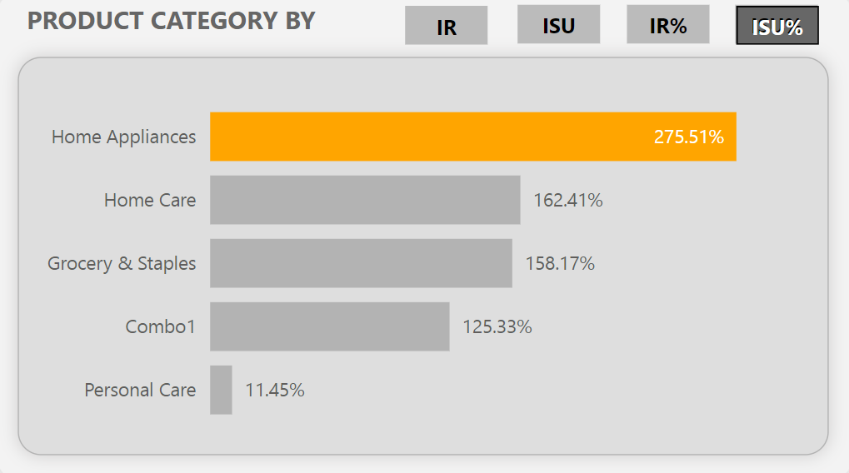
SANKRANTI

Slide 70

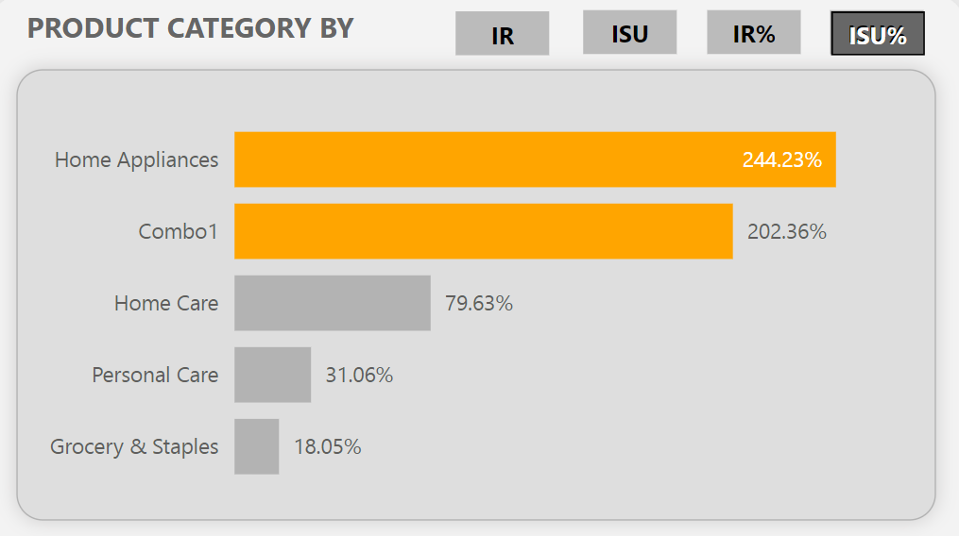
DIWALI

Slide 71






PRODUCTS ANALYSIS
These Bar Graphs shows the IR% in respect of the 5 categories of the products .
Observations from the graphs are :
The IR% of Combo is tremendous in all the campaigns.
Personal care Category have negative ISU% in both the campaigns.
ISU% (Percentage Increase in Sold Units in following campaign compared to the week before the campaign.)

Slide 72

BOTH CAMPAIGNS

Slide 73

SANKRANTI

Slide 74

DIWALI

Slide 75




PRODUCTS ANALYSIS

Slide 76



PROMOTIONS ANALYSIS
These Column Charts shows the IR% in respect of the 5 promotional offer.
Observations from the graphs are :
The IR% of 500 Cashback offer is sky touching in all the campaigns.
Cashback and BOGOF did well but all % OFF offers results in failed try.
All % OFF offers have negative IR% in all the campaigns.
IR% (Percentage Increase in Total Revenue Generated in following campaign compared to the week before the campaign.)

Slide 77

BOTH CAMPAIGNS

Slide 78

SANKRANTI

Slide 79

DIWALI

Slide 80



PROMOTIONS ANALYSIS
These Column Charts shows the ISU% in respect of the 5 promotional offer.
Observations from the graphs are :
The ISU% of BOGOF offer is tremendous in all the campaigns.
25 % offer did negative.
ISU% (Percentage Increase in Sold Units in following campaign compared to the week before the campaign.)

Slide 81

BOTH CAMPAIGNS

Slide 82

SANKRANTI

Slide 83

DIWALI

Slide 84
INDIVIDUAL PRODUCT ANALYSIS

Slide 85








INDIVIDUAL PRODUCT ANALYSIS
These Bar Graphs shows the ISU% in respect of the all individual products .
Observations from the graphs are :
The ISU% of Immersion Rod is tremendous in whole combined campaign. In Diwali campaign the top product is Immersion Rod, while in Sankranti, It is Sunflower Oil.
Personal care Category have lowest ISU% in both the campaigns.
ISU% (Percentage Increase in Sold Units in following campaign compared to the week before the campaign.)

Slide 86


BOTH CAMPAIGNS

Slide 87

DIWALI

Slide 88

SANKRANTI

Slide 89






INDIVIDUAL PRODUCT ANALYSIS
These Bar Graphs shows the IR% in respect of the all individual products .
Observations from the graphs are :
The ISU% of Immersion Rod is tremendous in whole combined campaign. In Diwali campaign the top product is Immersion Rod, while in Sankranti, It is Sunflower Oil.
Personal care Category have lowest ISU% in both the campaigns.
ISU% (Percentage Increase in Sold Units in following campaign compared to the week before the campaign.)

Slide 90


BOTH CAMPAIGNS

Slide 91

DIWALI

Slide 92

SANKRANTI

